Slide 1
Taking Your Craft Seriously with F#
Tomas Petricek
F# WORKS | www.fsharpworks.com | tomas@tomasp.net

Slide 2
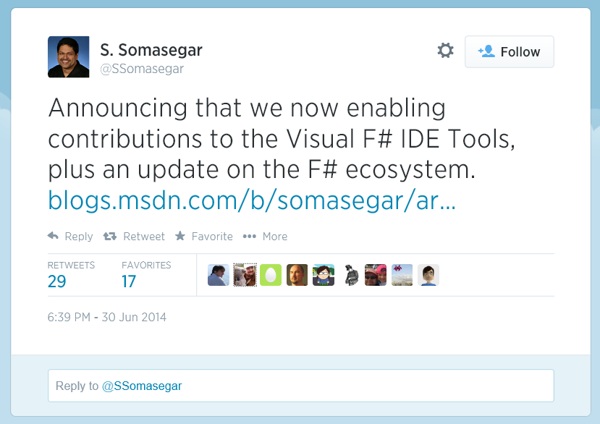
F# and open source

Slide 3
F# and open source
Core open-source components
http://github.com/fsharp
F# Projects Incubation
http://github.com/fsprojects
Visual F# (Compiler and VS Tools)
http://visualfsharp.codeplex.com

Slide 4
Open source is fun, but…
Testing is pain!
Building & releasing is pain!
Documentation is pain!

Slide 5
Using F# as a tool
Low-risk entry point for F#
Makes boring tasks fun
Not “production code”
Who uses F# as a tool?
GitHub Octokit, BlueMountain
Tachyus, e.on, etc.

Slide 6
F# libraries
FAKE (F# Make)
Writing build scripts with F#
F# Formatting
Awesome documentation
F# Project Scaffold
Easy-to-use GitHub template
FsUnit & FsCheck
DSL for readable tests
Random-testing framework
Deployment, NuGet, etc.
Markdown & Literate F#
Build, Tests, Docs, etc.

Slide 7
Demo
Email validation library

Slide 8
Why write tests in F#?
Testing .NET code
Use different language to avoid bugs
Compare collections with structural equality
Testing F# code
Result fully determined by inputs (no mocking)
Available tools
Standard .NET tools + Interesting F# libraries

Slide 9
FsUnit
DSL over NUnit constraints
More human readable tests
http://github.com/fsharp/FsUnit
[<Test>]
let ``2 + 2 should equal 4``() =
2 + 2 |> should equal 4
[<Test>]
let ``ships should end with ps``() =
"ships" |> should endWith "ps"

Slide 10
Demo
Testing simple F# library

Slide 11
FsCheck
Random testing framework for F#
Tests that a property is true for random inputs
http://github.com/fsharp/FsCheck
[<Test>]
let ``Reverse of a reverse is original``() =
let prop (xs:list<int>) =
List.rev(List.rev xs) = xs
Quick.check prop

Slide 12
Light-weight mocking
F# Object Expressions
Mocking libraries
Standard .NET libraries work with F#
F# friendly Foq: http://foq.codeplex.com
let requirement =
{ new IRequirement with
member x.IsSatisfied pwd = false }
requirement.IsValid("hi") |> should equal false

Slide 13
Demo
Mocking and FsCheck

Slide 14
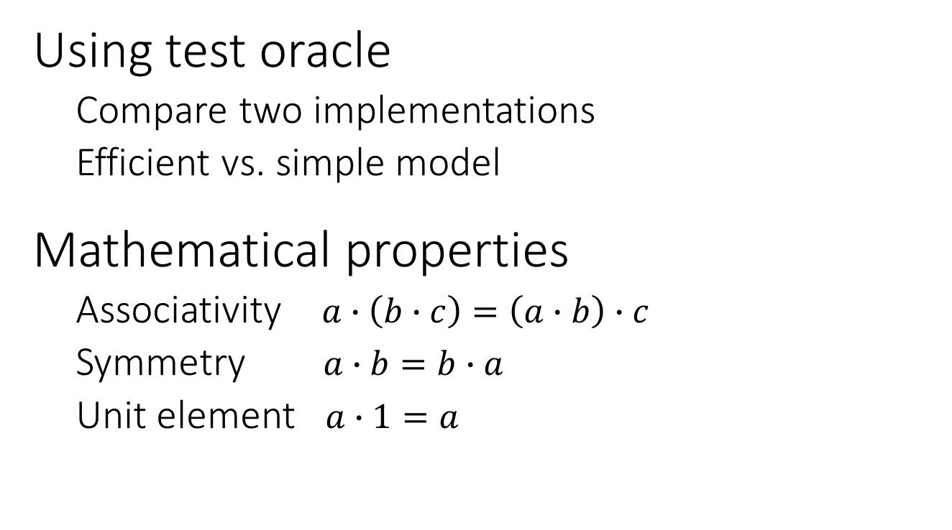
Writing good FsCheck tests
Using test oracle
Compare two implementations
Efficient vs. simple model
Mathematical properties
Associativity $a∙\left(b∙c\right)=\left(a∙b\right)∙c$
Symmetry $a∙b=b∙a$
Unit element $a∙1=a$

Slide 15
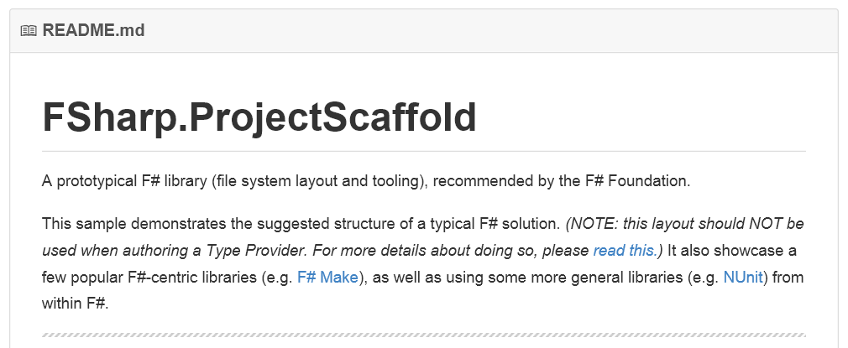
F# Project Scaffold
Template for F# libraries
Created in New York, November 2013 ☺
https://github.com/fsprojects/FSharp.ProjectScaffold

Slide 16
Demo
Creating library using F# Scaffold

Slide 17


F# scripting & documenting
FAKE – F# Make
Building, testing, deployment
Standard F# make system
Used by GitHub and others
F# Formatting
Scripts with Markdown comments
Embeds and formats snippets
Automatically emebed output

Slide 18
F# Formatting documentation
(**
Analyze function
----------------
The following snippet shows how the function: *)
(*** define-output: analyze ***)
let res = FinStats.analyze prices
printf "Drift: %f" res.Drift
(*** include-output: analyze ***)
Double ** starts Markdown comment
Include-output embeds result of a snippet
Standard Markdown is supported

Slide 19
Demo
Creating nice documentation

Slide 20
Building with FAKE
Specifying build targets
High-level primitives (MS Build, etc.)
Specifying target dependencies
Target "Build" (fun _ ->
!! "./**/FinLib.fsproj"
|> MSBuildRelease "" "Rebuild" |> ignore
)
"Build" ==> "RunTests" ==> "All"
"GenerateDocs" ==> "All"

Slide 21
Demo
Building, packaging & releasing

Slide 22
Summary
Boring tasks…
Unit testing, building & documenting
…don’t have to be boring!
Great and used libraries
FsUnit, FsCheck, FAKE, F# Formatting
Risk-free way of introducing F#
Production code is only 30% (???)

Slide 23
F# Resources & Events
F# Software Foundation
http://fsharp.org – The starting point
F# Works
http://fsharpworks.com/
Progressive F# Tutorials New York
https://skillsmatter.com/

